Slide 1
Smart trash can
Carolina Villarreal

Slide 2
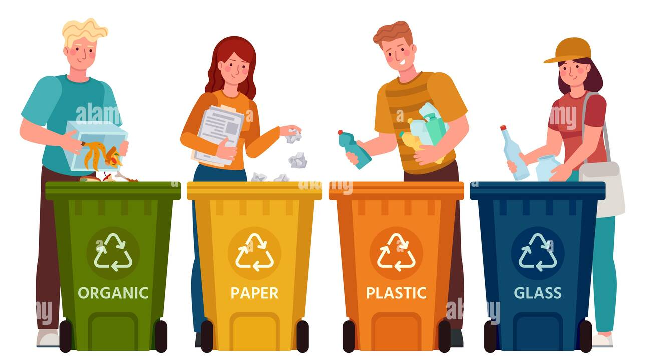
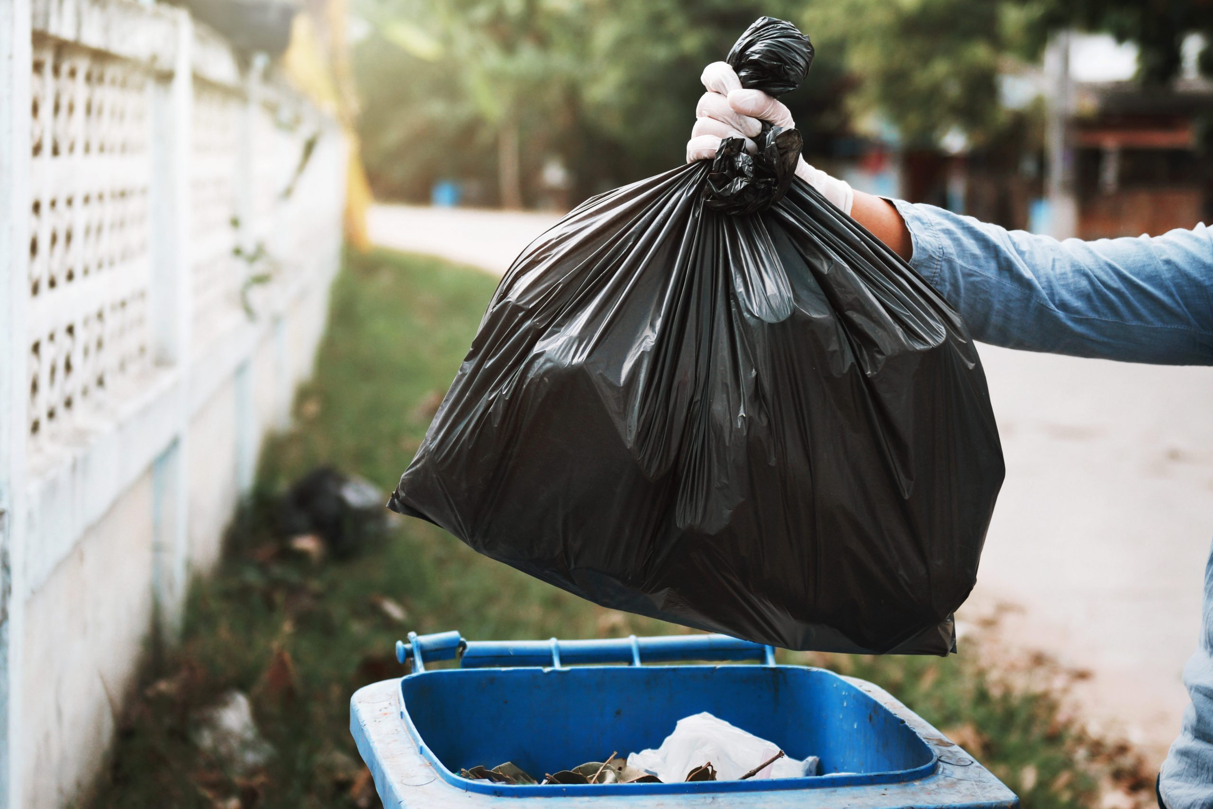
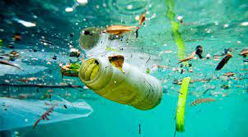

issues
2018
24.3 million tons per month.
Recycling rate for municipal solid waste (MSW) was about 32.1%

Slide 3
Objective
Increase the percentage of recycled materials
There are several reasons why improving recycling activities is important:
Environmental Benefits.
Economic Benefits.
Resource Conservation.
Reduce Pollution
Social Benefits
Overall, improving recycling activities is important for both environmental and economic reasons, and can help to promote a more sustainable and equitable future.
Notes:
There are several reasons why improving recycling activities is important:
Environmental Benefits: Recycling reduces the amount of waste that ends up in landfills, which can help to reduce the environmental impact of waste disposal. It also conserves natural resources by reducing the need for raw materials to be extracted and processed, which can help to conserve energy and reduce greenhouse gas emissions.
Economic Benefits: Recycling can also create economic benefits by generating jobs and revenue for local communities. It can also reduce the costs associated with waste disposal, as recycling is often less expensive than landfilling or incineration.
Resource Conservation: Recycling helps to conserve valuable resources such as metals, paper, and plastics. By recycling these materials, we can reduce the need to extract and process new raw materials, which can help to conserve natural resources and reduce energy consumption.
Reduce Pollution: Recycling can also help to reduce pollution by reducing the amount of waste that is sent to landfills or incinerated. Landfills and incinerators can emit pollutants such as methane and carbon dioxide, which contribute to climate change and other environmental problems.
Social Benefits: Improving recycling activities can also have social benefits by promoting community involvement and engagement. Recycling programs can help to raise awareness about the importance of waste reduction and environmental stewardship, and can encourage individuals to take action to reduce their environmental impact.
Overall, improving recycling activities is important for both environmental and economic reasons, and can help to promote a more sustainable and equitable future.

Slide 4

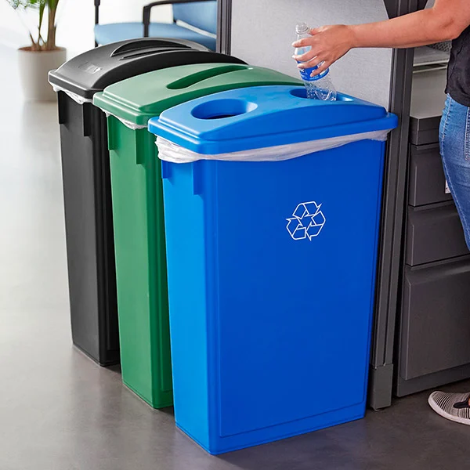
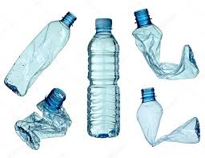
1
3
2

Slide 5
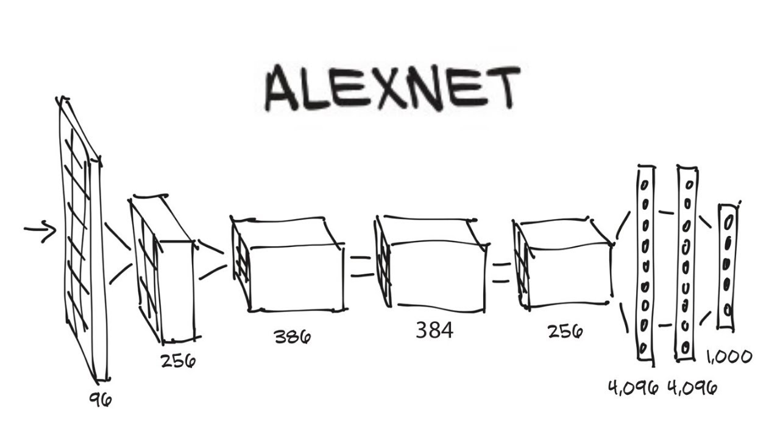
Alexnet
AlexNet is a convolutional neural network (CNN) architecture that was originally developed for image classification tasks. It was designed specifically for the ImageNet Large Scale Visual Recognition Challenge (ILSVRC) in 2012, and achieved state-of-the-art results on this dataset at the time.
AlexNet can be used for a variety of computer vision tasks, including image classification, object detection, and image segmentation. It is particularly well-suited for large-scale image classification tasks, where the goal is to classify images into one of many different categories.

Slide 6
Alexnet
Get the pixels
Extract features
Classify with regular layers
No matter the size or position

Slide 7
